Slide 1

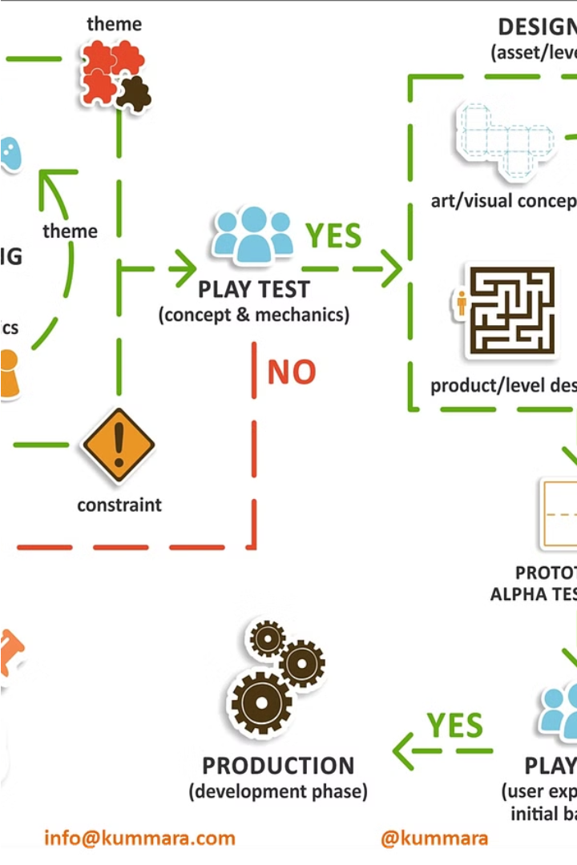


Creating a New Video Game: Step-by-Step Guide
This comprehensive guide will take you through the entire process of conceptualizing, developing, and launching a brand-new video game. From the initial spark of an idea to the triumphant release, you'll learn the essential steps to turn your gaming vision into a reality.
by Fogogelado o

Slide 2



Concept Development
Brainstorming
1
Gather inspirations from various sources
Market Research
2
Identify industry trends and target audience
Concept Document
3
Outline game genre, story, mechanics, and unique selling points
The concept development phase is crucial for laying the foundation of a successful video game. It begins with brainstorming ideas and gathering inspirations from various media, such as films, books, and other games. This is followed by thorough market research to identify industry trends and understand the target audience's preferences and needs. The culmination of this process is the creation of a detailed concept document that outlines the game's genre, story, core mechanics, and unique selling points that will differentiate it from the competition.

Slide 3
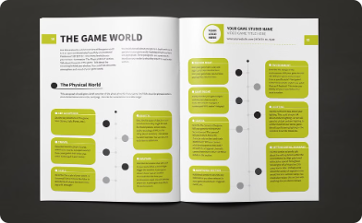
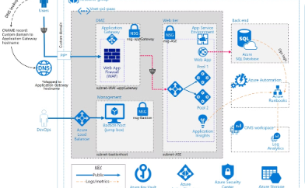
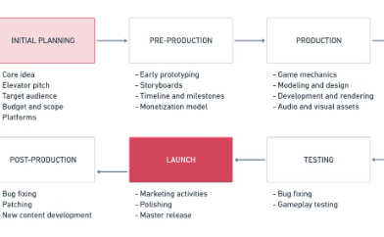
Planning and Pre-Production
Game Design Document (GDD)
Technical Design Document (TDD)
Careful Planning
During the pre-production phase, the development team carefully plans and documents every aspect of the game, from the creative vision to the technical implementation. This thorough planning helps ensure a smooth and successful production process, minimizing risks and maximizing the chances of delivering a high-quality game on time and within budget.
The GDD is a comprehensive document that outlines the detailed gameplay mechanics, storyline, characters, and level design for the video game. This serves as a roadmap for the development team, ensuring everyone is aligned on the game's vision and objectives.
The TDD specifies the platform requirements, technical specifications, and development milestones for the project. This document helps the team understand the technical feasibility and constraints, allowing them to plan the production process efficiently.

Slide 4
Building the Team
Key Roles
Team Dynamics
Successful video game development requires a talented and diverse team. The key roles include designers who conceptualize the gameplay, programmers who bring the code to life, artists who create the visual elements, sound designers who craft the audio experience, writers who develop the narrative, and project managers who coordinate the overall effort.
Effective collaboration is essential for a video game team. Use project management tools and communication strategies to keep everyone aligned and informed. Foster a culture of open communication, feedback, and mutual respect. Regularly review progress, address challenges, and make adjustments to ensure the team works cohesively towards the shared goal.

Slide 5
Prototyping
Develop a Prototype
1
Test the core mechanics and fundamental gameplay.
Iterative Testing
2
Gather feedback from playtesters and continuously refine the design.
Refine and Iterate
3
Make improvements based on the insights gained from testing.
Prototyping is a crucial step in the video game development process. It allows you to experiment with core gameplay mechanics, test ideas, and gather valuable feedback before investing significant time and resources into full production. By developing a working prototype and iteratively refining it through playtesting, you can ensure that the final game is polished, engaging, and aligned with player expectations.

Slide 6




Production
Game Engine Development
Asset Creation
Gameplay Implementation
Designers and artists work closely to create all the visual and audio elements of the game, such as character models, environments, user interface, and sound effects. These assets are carefully crafted to enhance the overall player experience.
During the production stage, the game engine is coded to bring the game to life. This involves programming the core functionality, setting up the underlying systems, and implementing the game's mechanics and logic.
The gameplay mechanics conceptualized earlier are now implemented in the game engine. This includes player controls, enemy behaviors, challenges, and interactions that bring the game world to life and provide an engaging experience for players.

Slide 7

Art, Sound, and Level Design
1
Visual Design
2
Sound Design
Crafting the visual identity of a video game is a crucial aspect of the development process. This involves creating concept art, character models, and immersive environments that bring the game world to life. The visual design sets the tone and establishes the unique aesthetic that players will experience.
Audio plays a vital role in enhancing the player's experience. Developing the right background music, sound effects, and voice acting can deeply engage players and evoke specific emotions. Sound design helps to create an immersive and cohesive atmosphere that complements the visual elements of the game.
3
Level Design
Crafting levels and maps that are both engaging and balanced is a hallmark of great game design. Level designers must carefully consider the player's progression, integrate narrative elements, and ensure the right level of challenge. Their work is essential for creating an enjoyable and rewarding gameplay experience for the player.

Slide 8

Quality Assurance (QA)
Bug Testing
User Experience (UX) Testing
Player Feedback
Thorough bug testing is crucial to ensure your video game is free of glitches and errors. The QA team will meticulously comb through every aspect of the game, from gameplay mechanics to user interfaces, to identify and fix any bugs or technical issues that could impact the player experience.
The QA process doesn't end at launch. The team will continue to monitor player feedback and data to identify any lingering issues or areas for improvement. This will inform future updates and patches to keep the game running smoothly and improve the experience over time.
Beyond just fixing bugs, the QA team will also focus on optimizing the player's overall experience. They'll assess factors like navigation, pacing, difficulty, and accessibility to ensure the game is intuitive, engaging, and satisfying for users of all skill levels.

Slide 9

Marketing, Launch, and Post-Launch
1
Marketing
Develop a comprehensive marketing plan to build excitement and awareness for your new video game. Leverage the power of social media platforms to share captivating trailers, behind-the-scenes glimpses, and engaging content that resonates with your target audience. Invest in strategic partnerships and influencer collaborations to amplify your reach and credibility.
2
Launch
Before launching your game, conduct rigorous final quality assurance checks to ensure a smooth and seamless player experience. Distribute your game through reputable digital stores, making it easily accessible to your eager audience. Coordinate a well-timed release, building momentum and capturing the attention of both casual and hardcore gamers.
3
Post-Launch Support
Maintain a strong connection with your community by promptly addressing player feedback and rolling out regular patch updates to address any issues or bugs. Engage with your audience through social media, forums, and live events to foster a sense of belonging and loyalty. Develop compelling downloadable content (DLCs) to expand the game's longevity and provide players with fresh, engaging experiences.

Slide 10

Conclusion and Q&A
In our journey from conceptualizing a new video game to its successful launch and beyond, we've covered a wide range of essential steps. From initial ideation and prototyping to building a talented team, navigating the production process, and ensuring meticulous quality assurance, each phase has been critical in shaping the final product. As we conclude this presentation, the key takeaway is the importance of adaptability and continuous improvement.
In this ever-evolving industry, game development requires a willingness to embrace change, learn from setbacks, and constantly refine the creative vision. By remaining open-minded and responsive to player feedback, developers can ensure their games remain engaging, relevant, and continuously enhanced long after the initial launch. With this mindset, the path from concept to post-launch success becomes an ongoing, iterative process, rather than a linear one-time event.
We now invite you, our esteemed audience, to share your questions and insights. This is an opportunity for us to address any remaining concerns, clarify aspects of the development process, and engage in a meaningful dialogue that can further strengthen your understanding of the intricacies involved in bringing a video game to life.

